Slide 1
Advanced Algorithms for THz Sensing and Recognition
Murat Torlak and Yiorgos Makris
April 5th, 2021 Review

Slide 2
Updates
Synergy with TxACE Teams
Progress Update: System Design and Construction
Real Images from Envelope Scanning Scenario
Corner reflector
Paper
Paper + metal cutout
Paper + metal hex nuts
Paper + staples
Conclusion

Slide 3
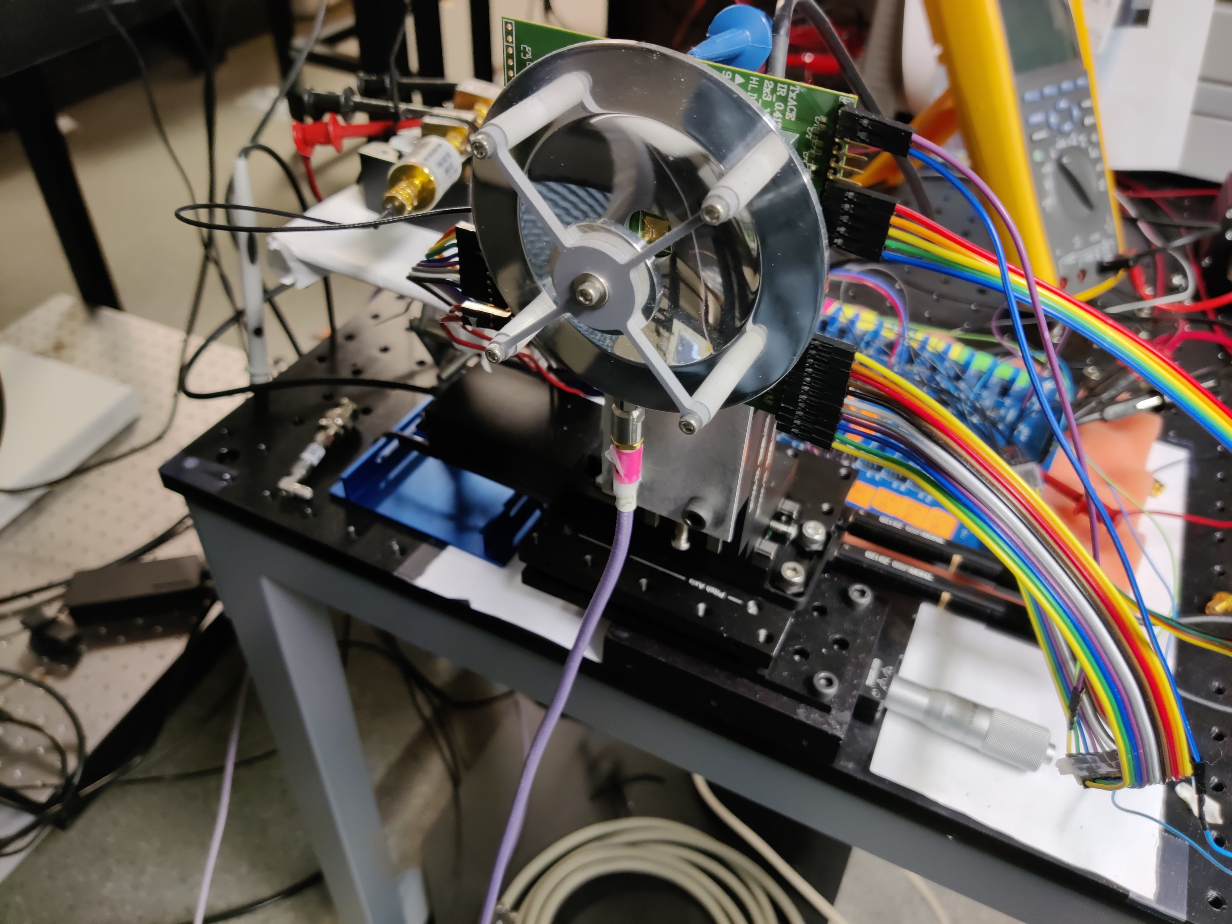
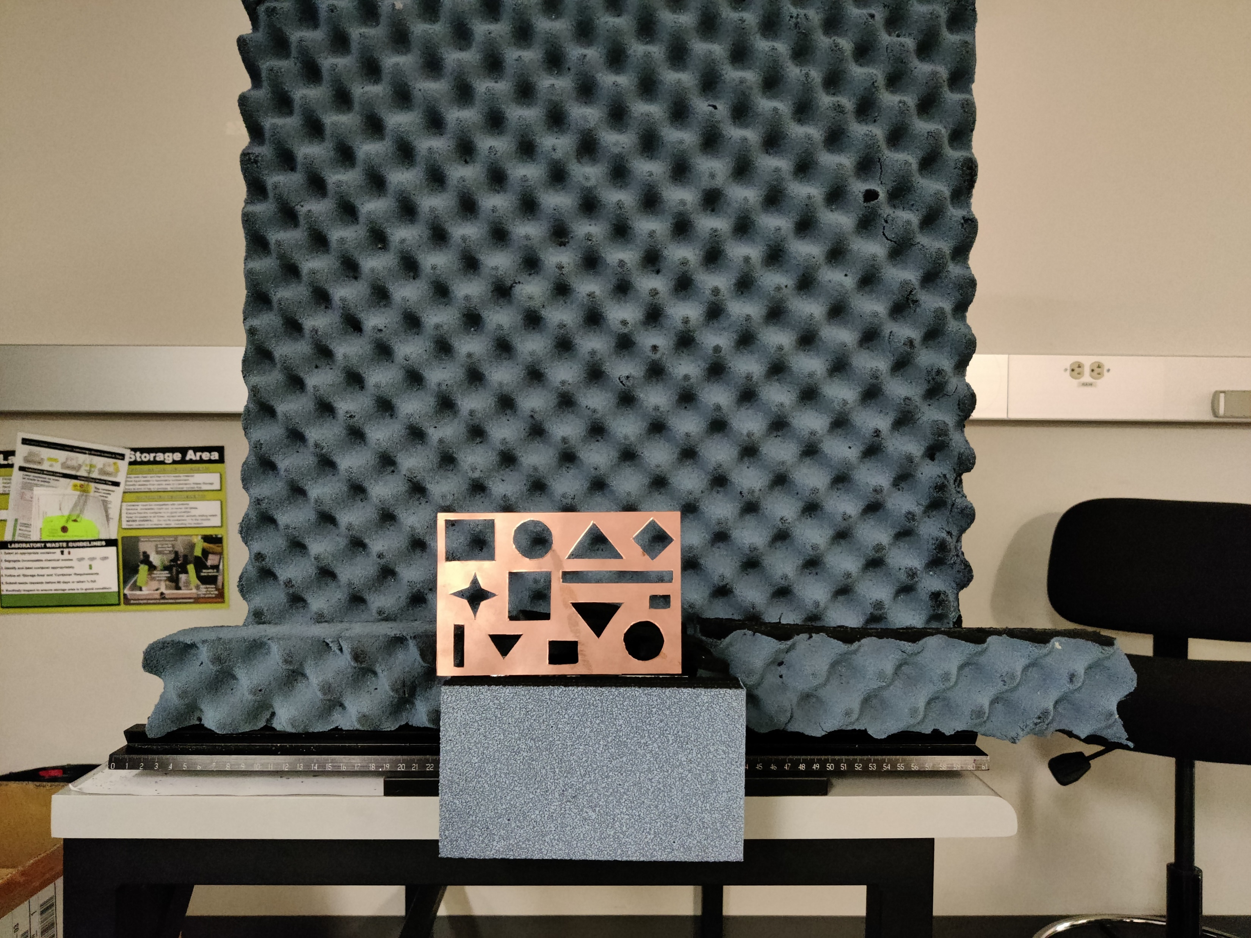

Synergy with TxACE Teams

Slide 4
Progress Update: System Design and Construction

Slide 5

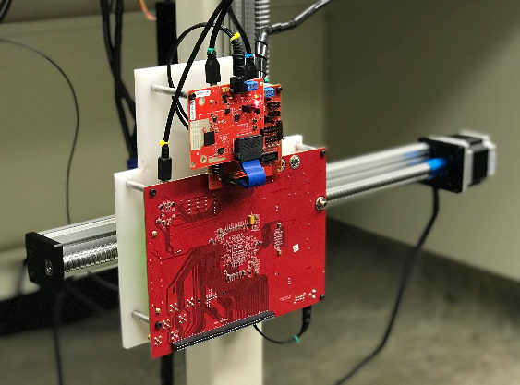
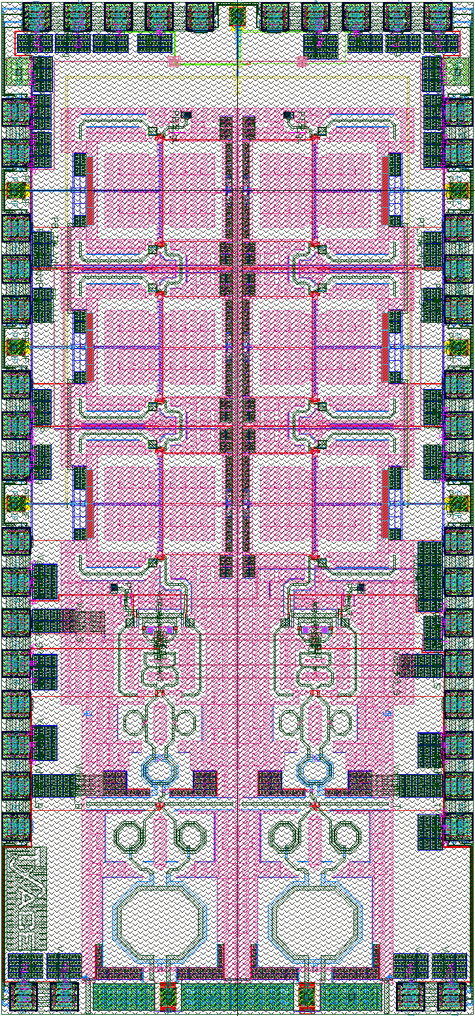

New Scanner
Mail inspection scanner
Requires downward-facing imaging system
Current system is vertically oriented
Working on a new, versatile system
1m

Slide 6
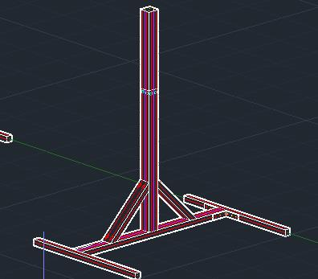
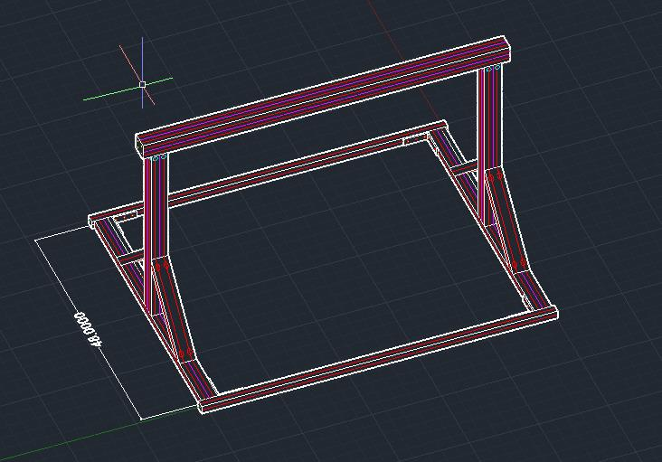
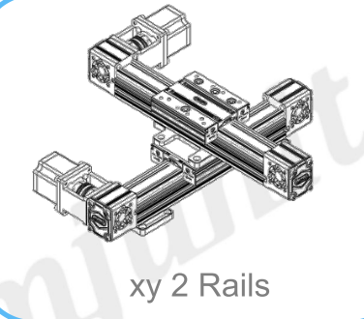
New Scanner
Updates:
Finished 3D CAD design and order in process
Ordered mechanical actuators and controller
Optimized scanner control software

Slide 7
Real Images from Envelope Scanning Scenario

Slide 8
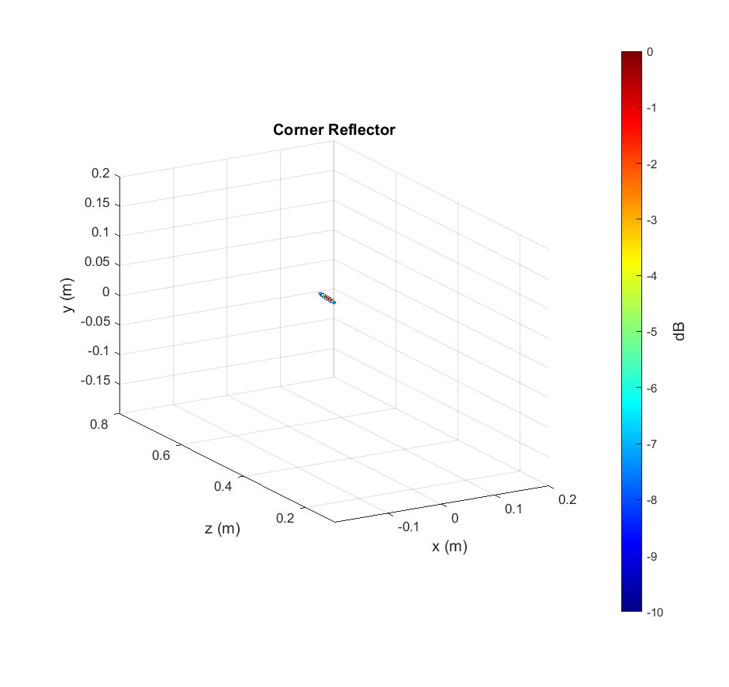
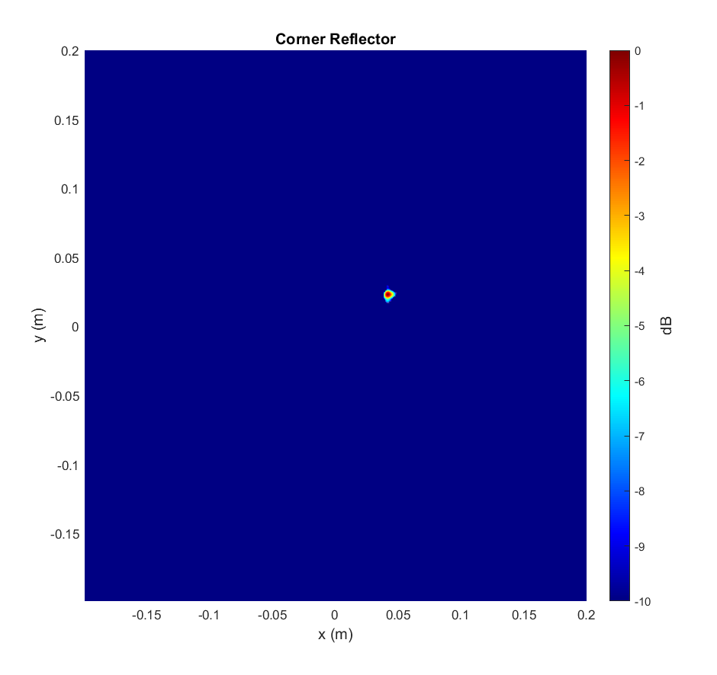
Corner Reflector

Slide 9
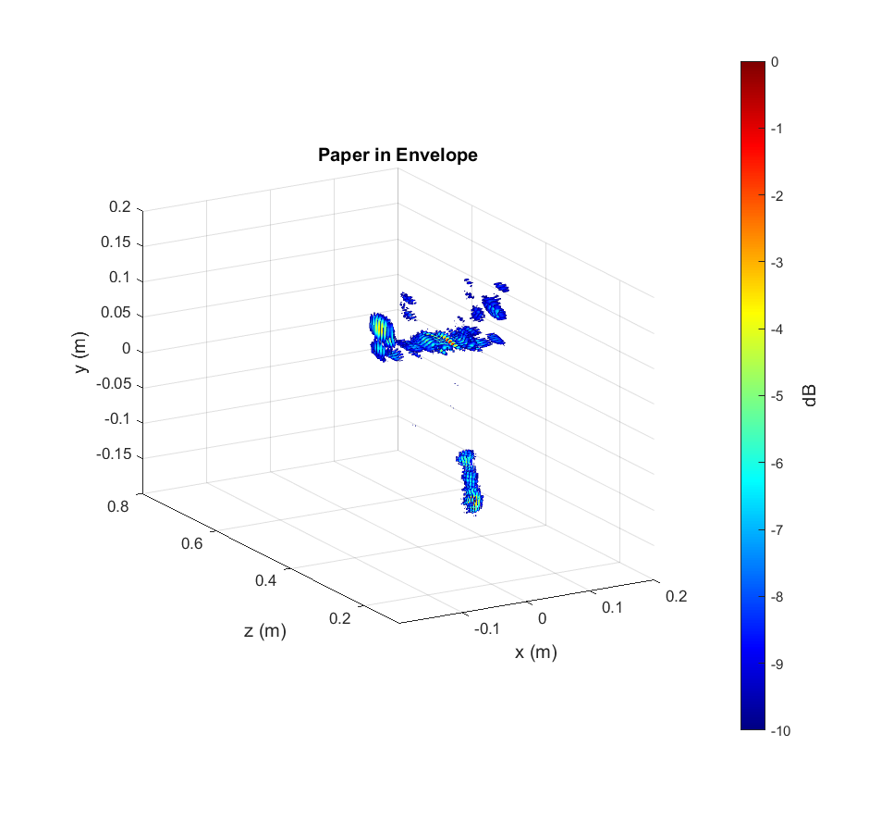
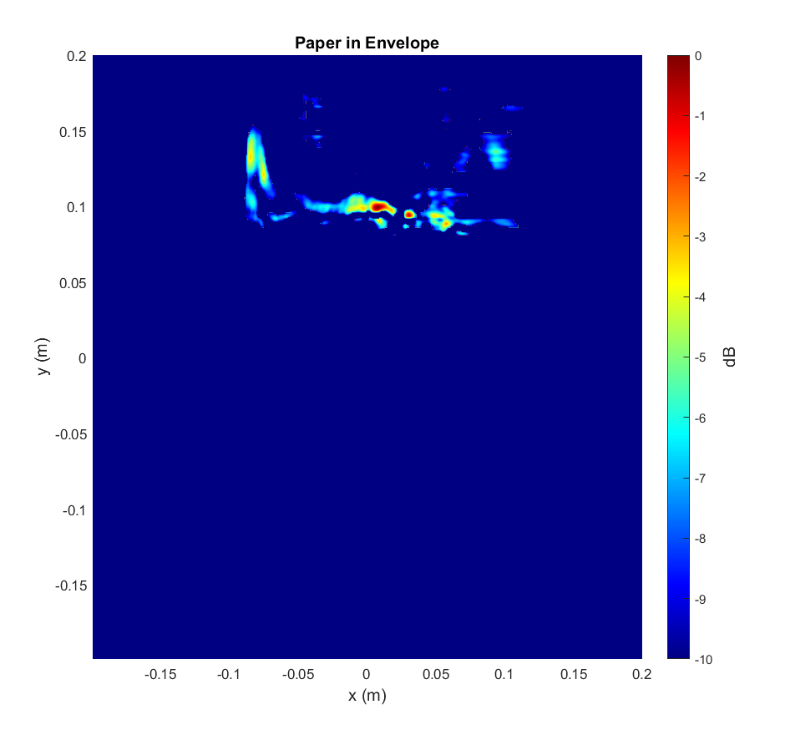
Paper in Envelope

Slide 10
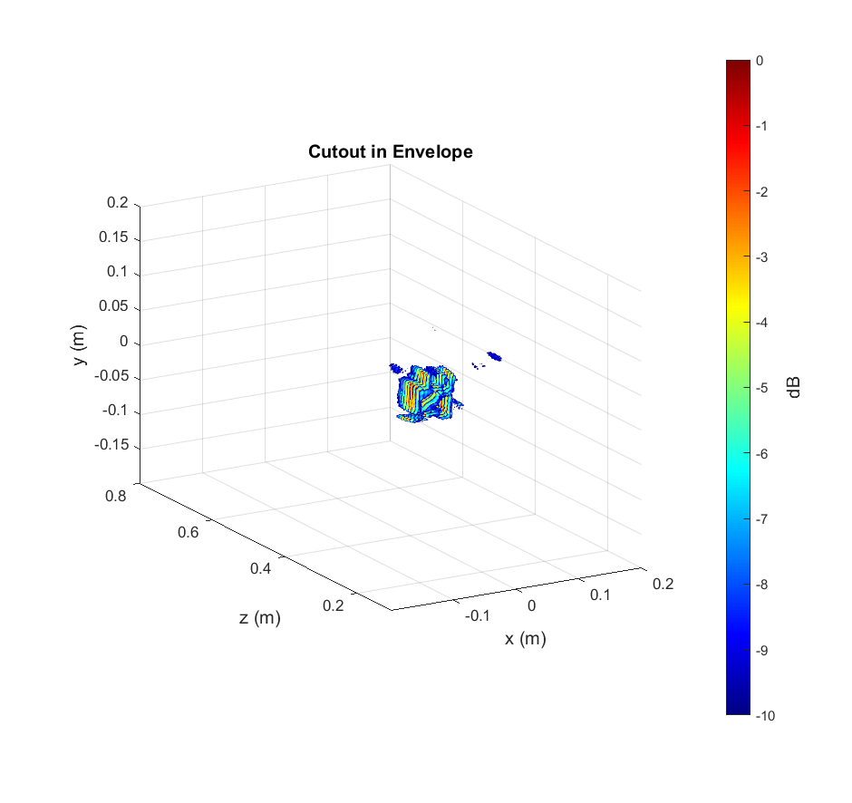
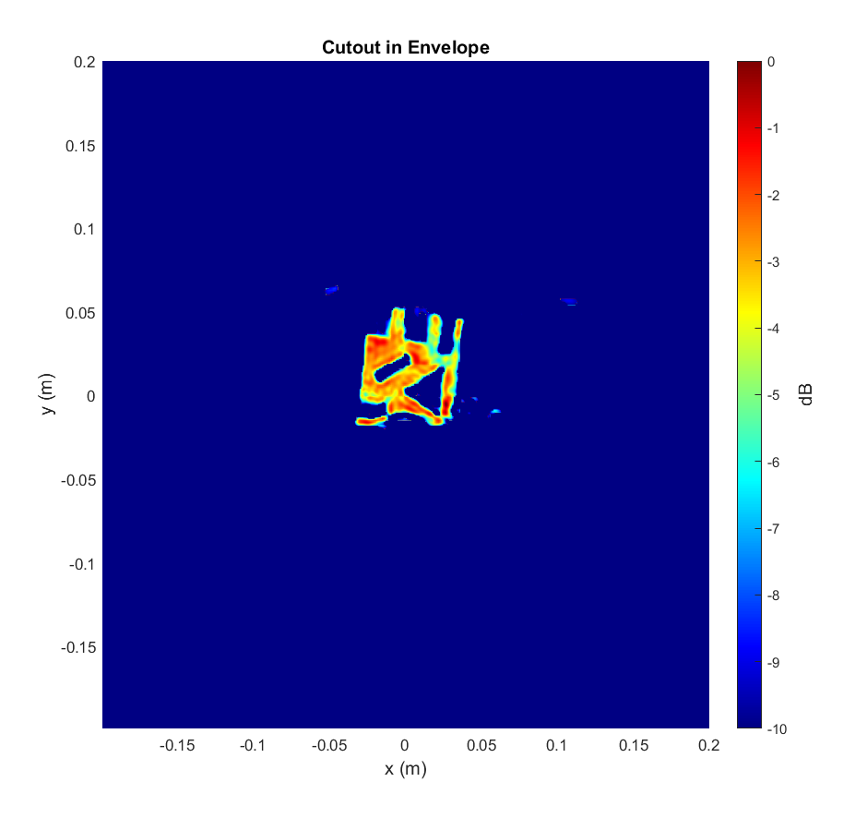
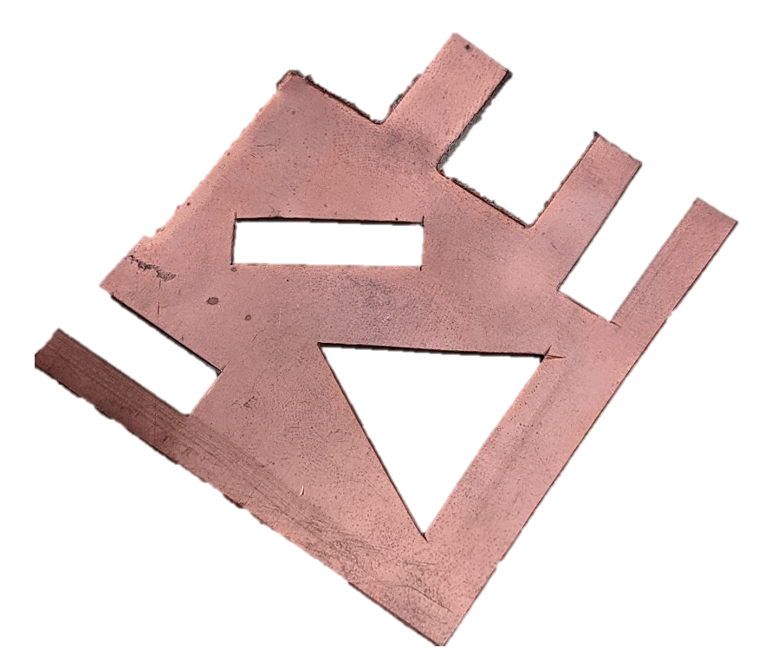
Cutout in Envelope (Behind Paper)

Slide 11
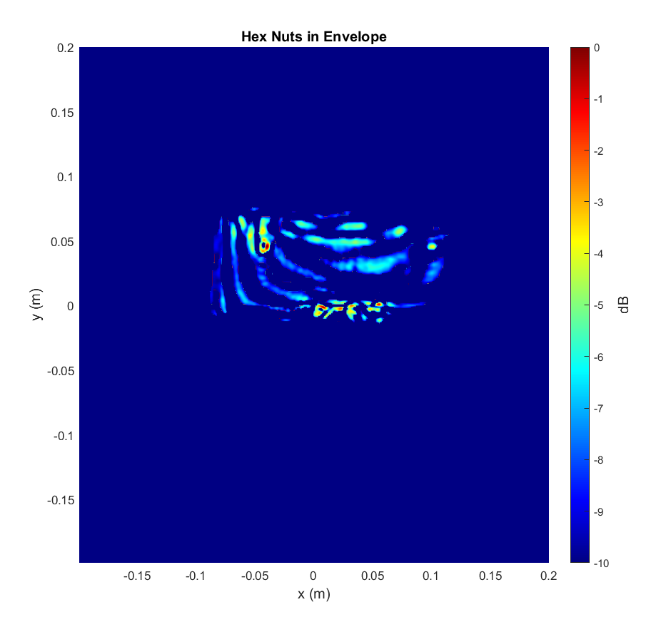
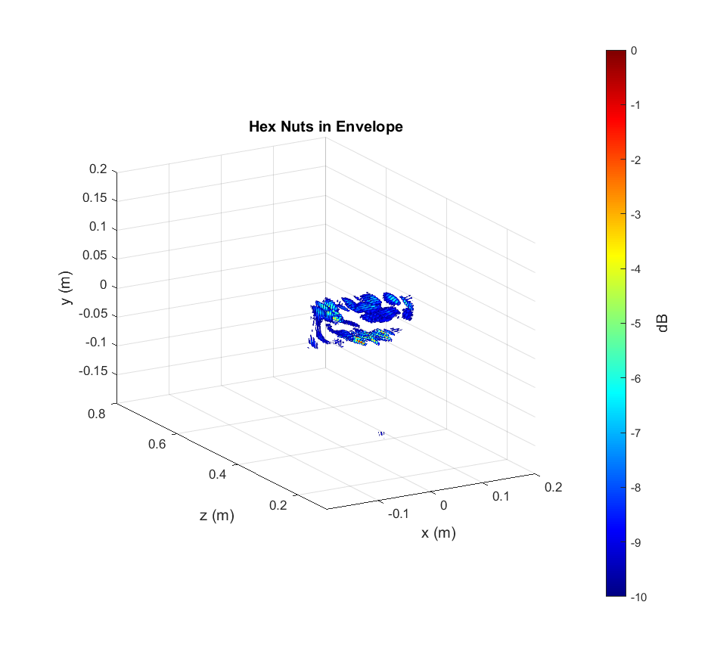
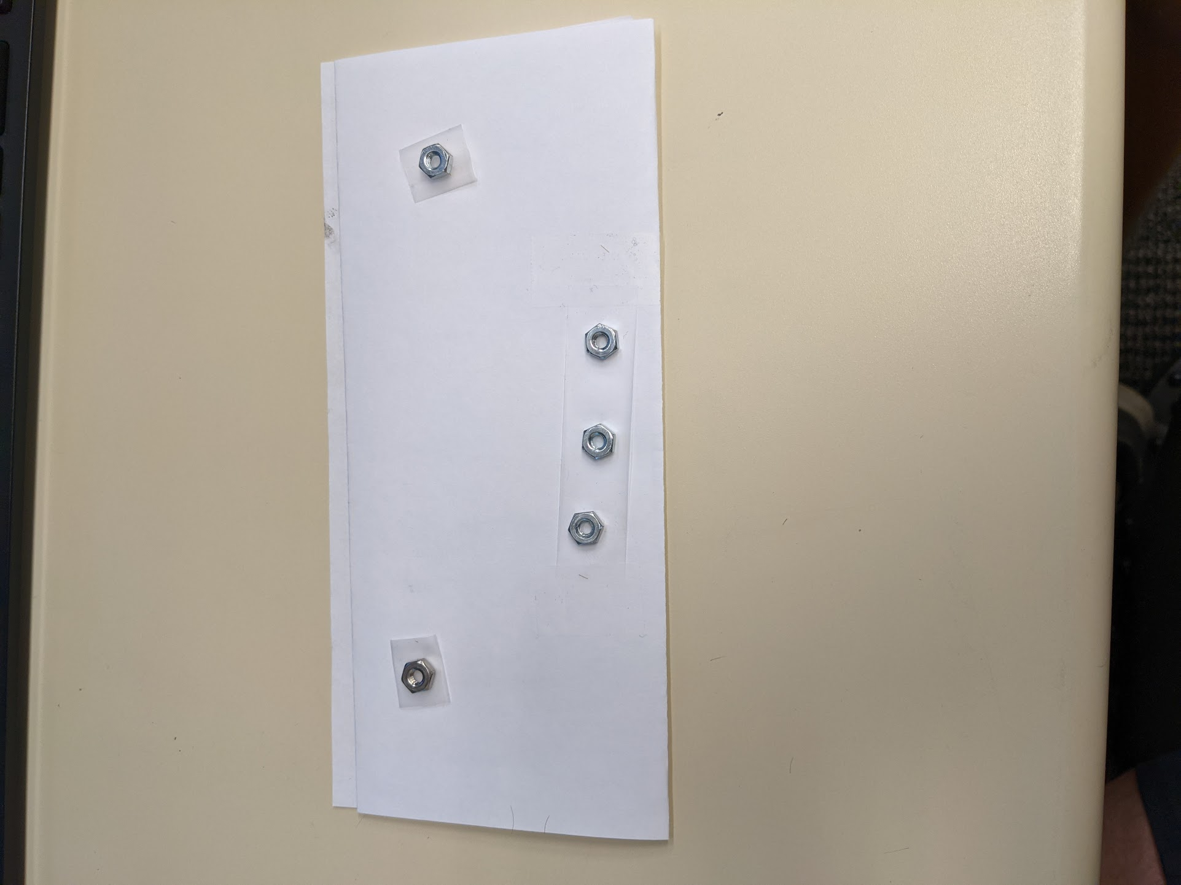
Hex Nuts in Envelope (Behind Paper)
Hex nuts near the bottom are not well resolved
Need some improvement

Slide 12
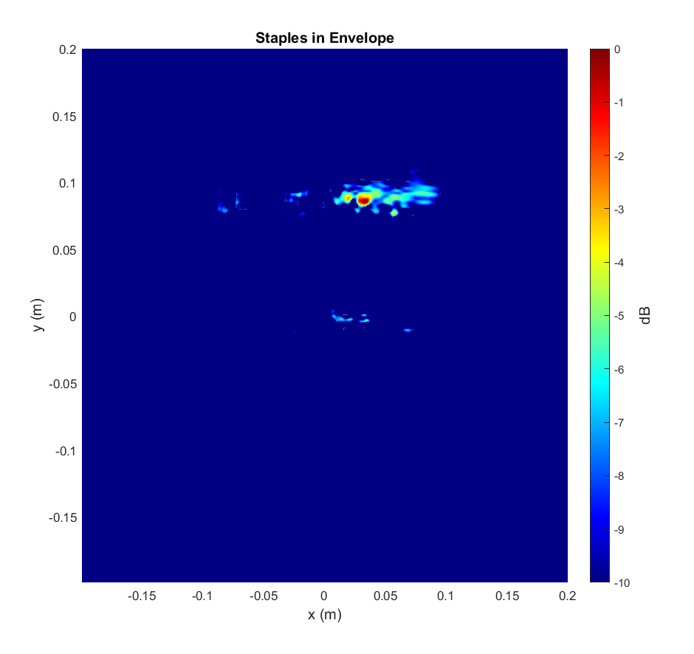
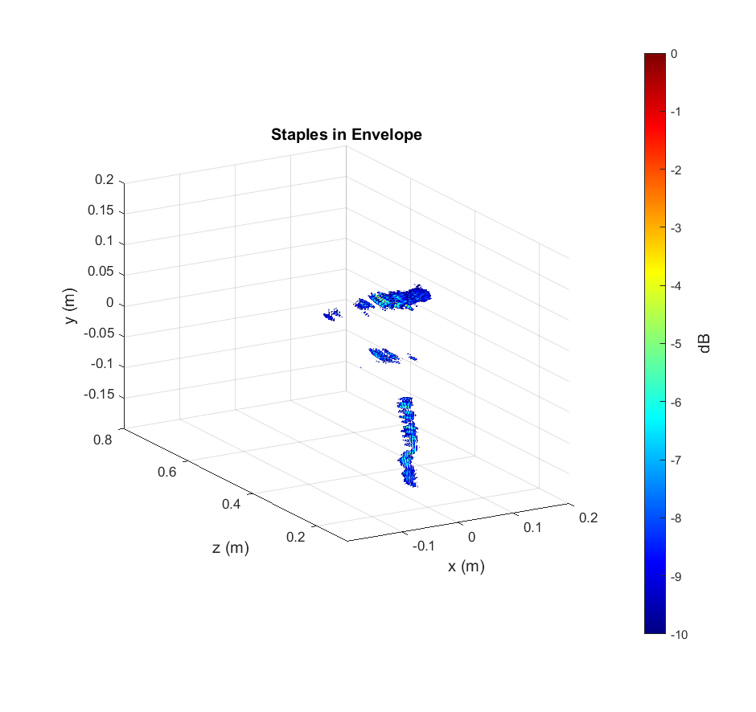
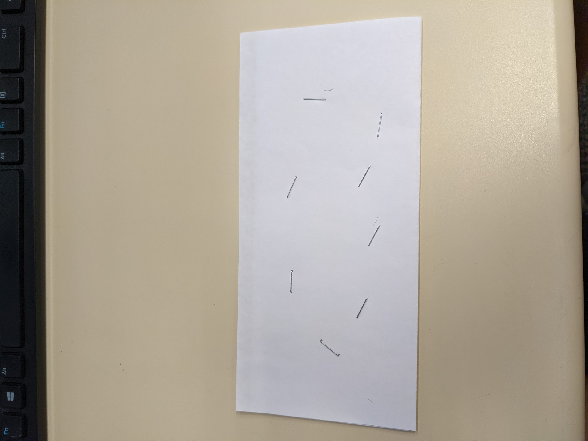
Stapled Paper in Envelope
Staples have low reflectivity (similar to that of particles in envelopes)

Slide 13
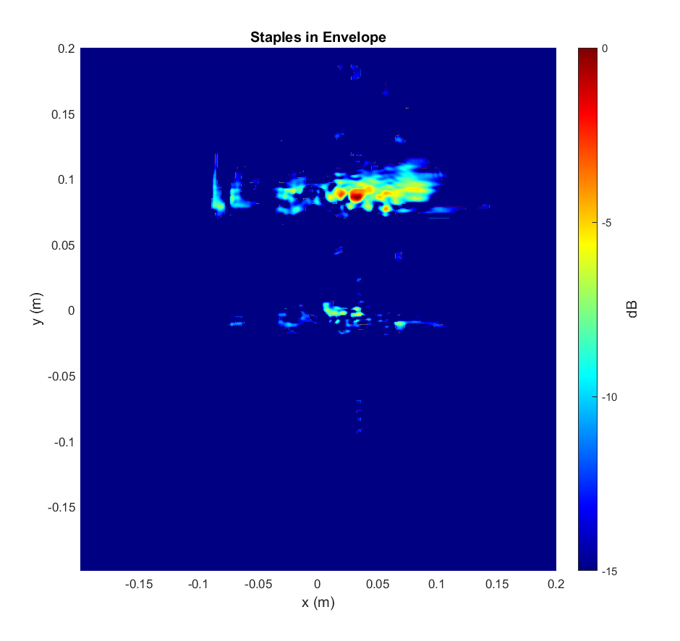
Stapled Paper in Envelope
MIMO Ghosts
Some staples are barely visible
Resolution can be improved by:
Larger aperture size
Higher frequency sensor
Deep learning enhancement
Low reflectivity detection
Our prior work: static gesture recognition, medical insert detection
Previous results: deep learning classification performs well even when human eye cannot distinguish noticeable difference from radar images

Slide 14
Conclusions
Continue synergy with AI team for improving resolution enhancement algorithms
System construction
New hardware coming for conveyor belt scenario
Conclusions from test images:
Larger items can be easily imaged from within envelope
Smaller items/particles require improved resolution
Need for super-resolution deep learning algorithms
Given current radar, scale expected resolution and detectible size

Slide 15
Backup Slides

Slide 16
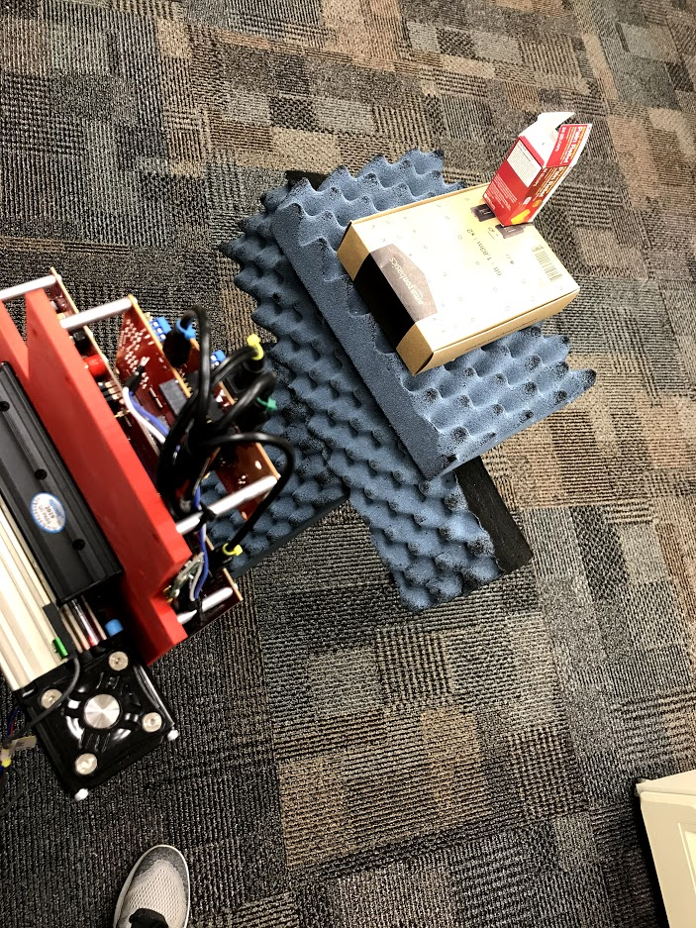
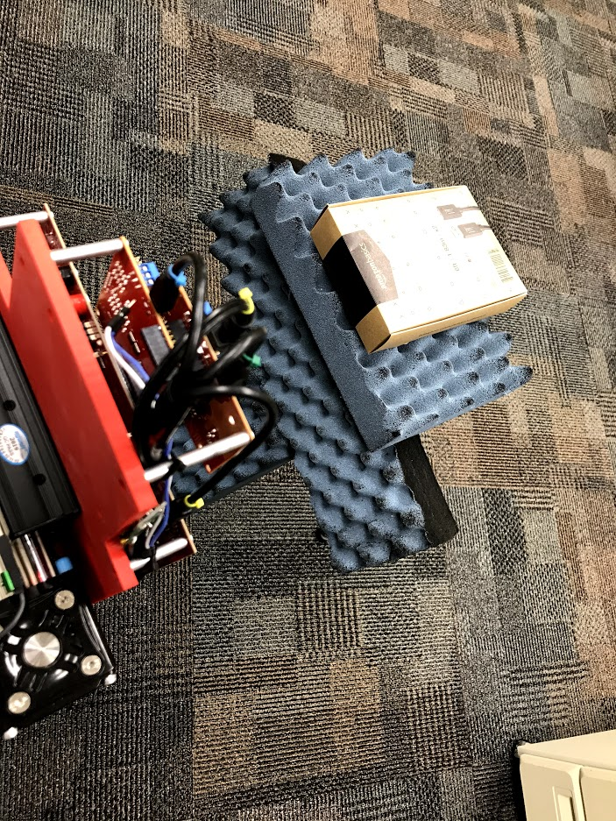
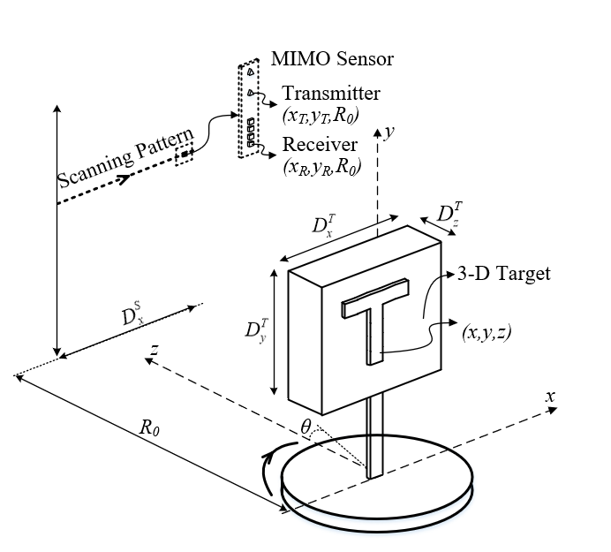
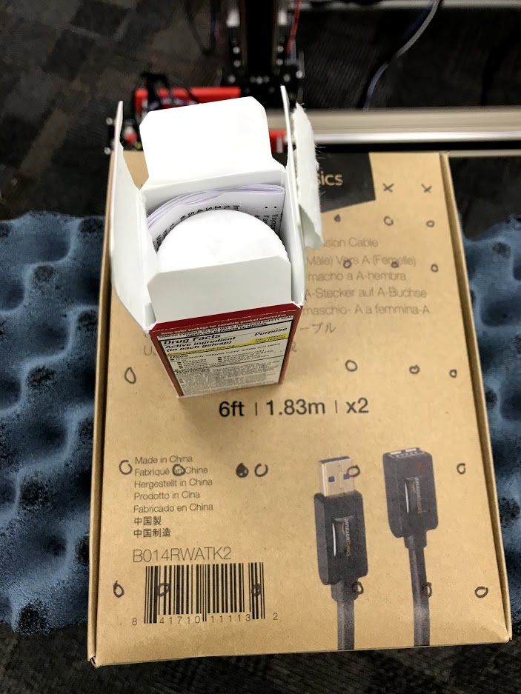
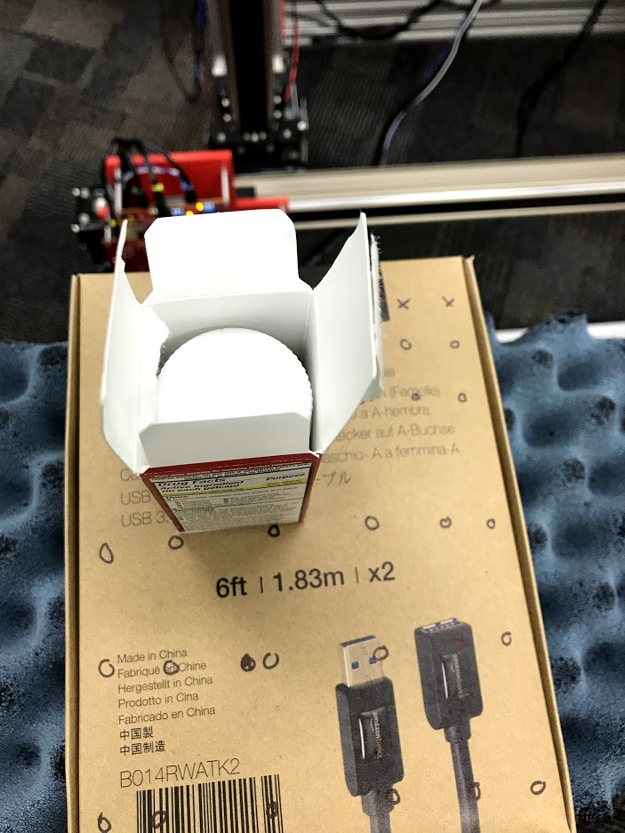
Medical Packaging Insert Detection
Box contains either:
Pills in bottle and insert
Pills in bottle and no insert

Slide 17
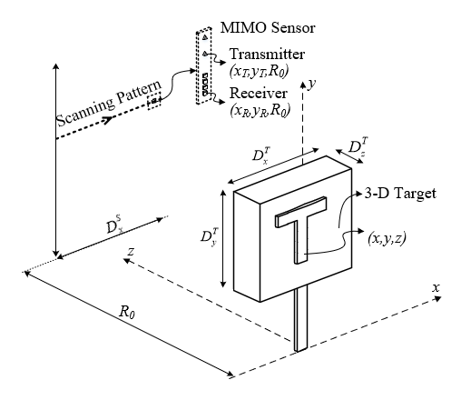

Conveyor Belt Scenario
Box moves along constant linear path
Orientation could be at any angle
Insert could face towards or away from radar
1000 samples/class
81% classification accuracy

Slide 18
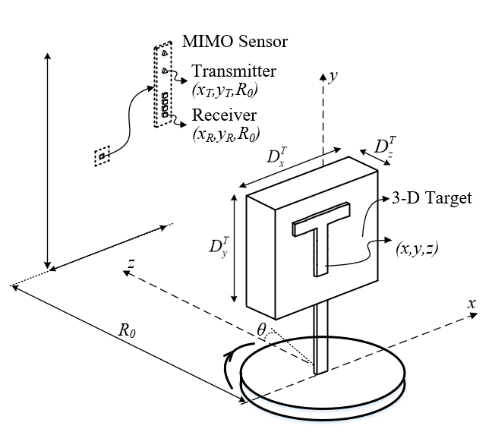
Rotator Scenario
Box is rotated in front of radar
Radar views all sides of the box
Multiple horizontal positions
4000 samples/class
99.9% classification accuracy

Slide 19
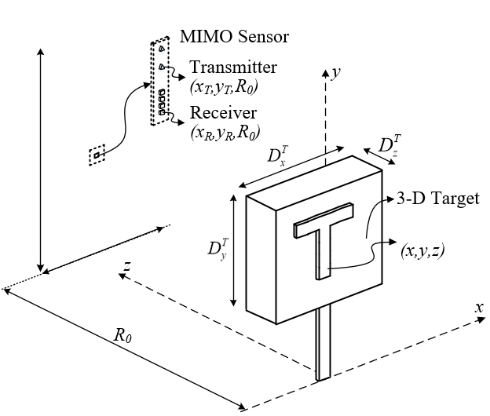
Static Captures
Still frames of box are captured
Box at multiple horizontal locations and orientations
More data points
400000 samples/class
82% classification accuracy

